Slide 1
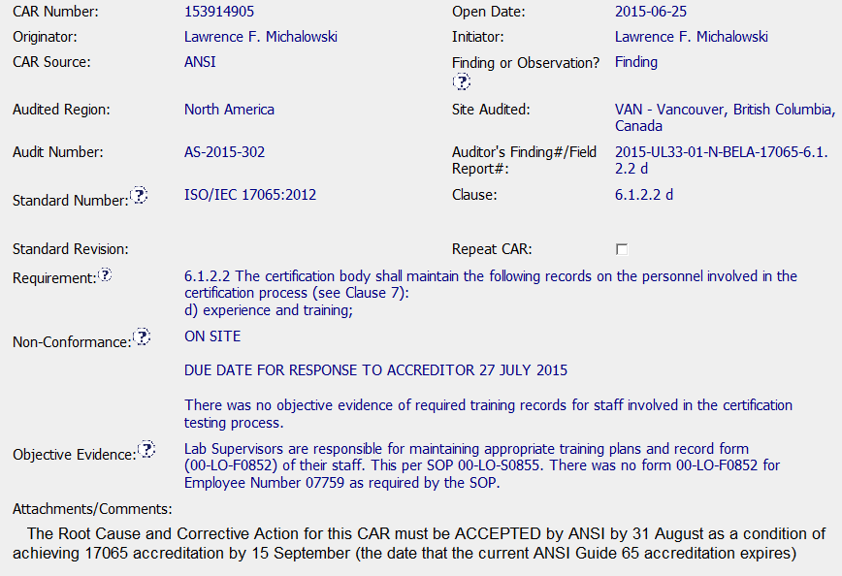
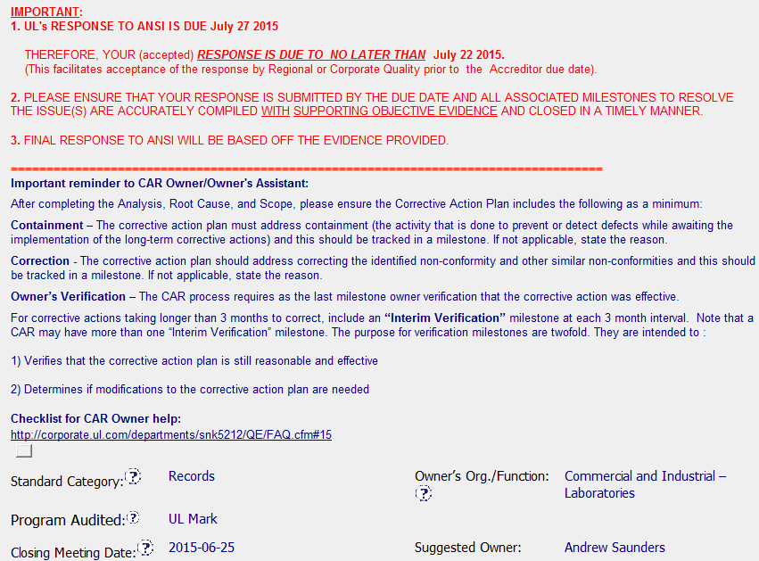
CAR 153914905 – Exemplary CAR (Finding)
All required information is present and clear (requirement, NCR, Objective Evidence, reference numbers, etc.).
All the critical Accreditor due date info is included.
Helpful Owner guidelines and links to additional resources included

Slide 2
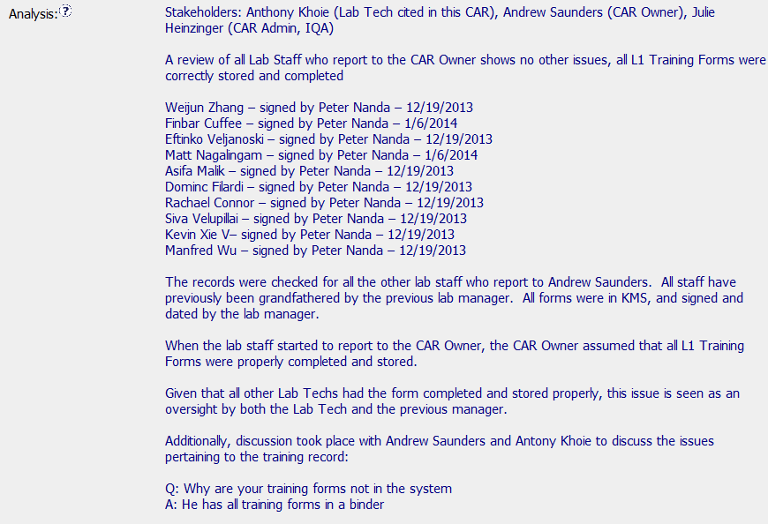
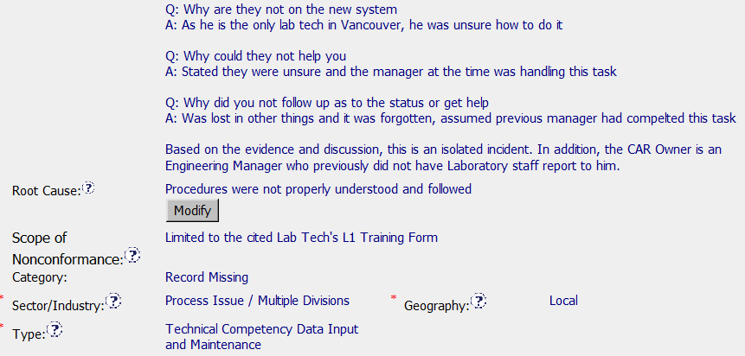
CAR 153914905 – Exemplary CAR (Finding)
Stakeholders identified
Thorough scope analysis
Clear RCA method (5 Why’s)
Succinct RC.
Analysis supports scope and RC.
Correct Category, Type, Sector/Industry and Geography selected.

Slide 3
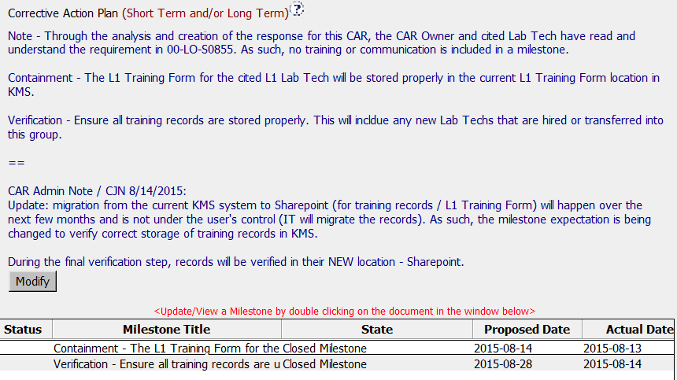
CAR 153914905 – Exemplary CAR (Finding)
Clear explanation why no training or communication milestone is required
Note added before closing the CAR to explain the minor change in the CAP.
Milestones match the CAP

Slide 4
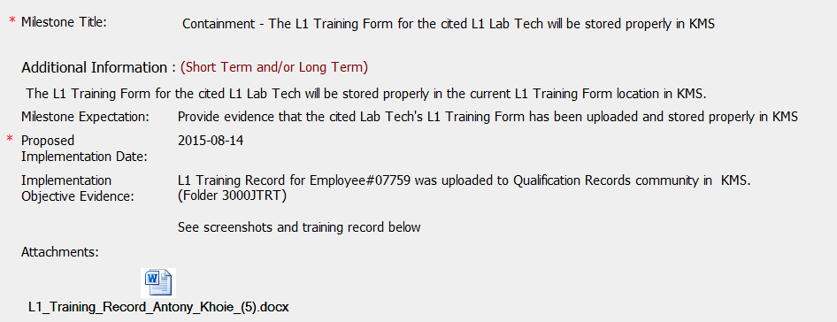
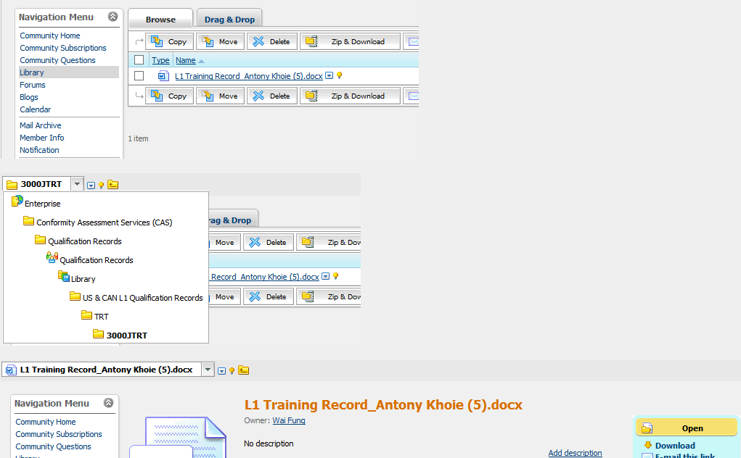
CAR 153914905 – Exemplary CAR (Finding)
Concise milestone expectation
Clear evidence, including attached form and evidence it has been stored correctly in KMS.

Slide 5
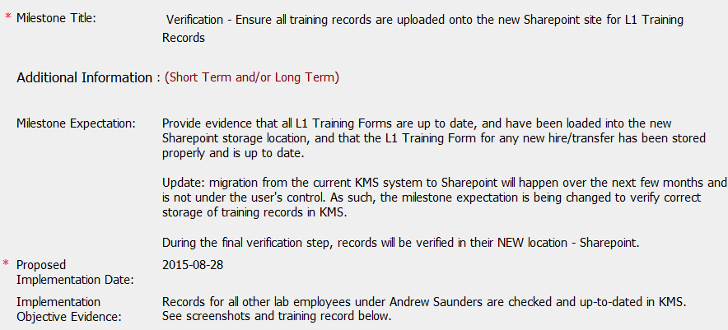
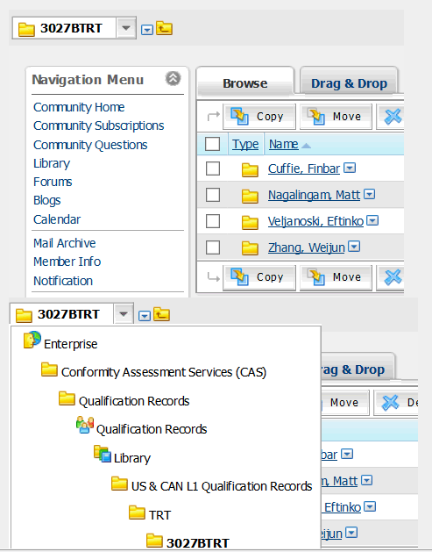
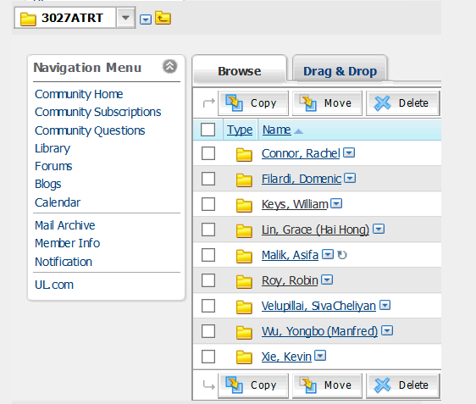
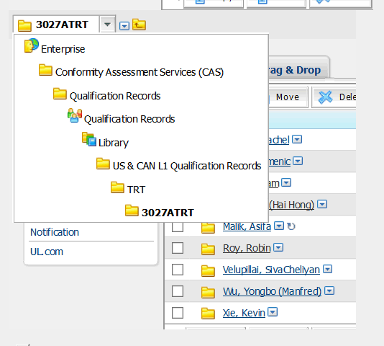
CAR 153914905 – Exemplary CAR (Finding)
Very detailed milestone expectation, updated when the storage location changed, before closing CAR.
Clear evidence, including attached form and evidence it has been stored correctly in KMS.

Slide 6
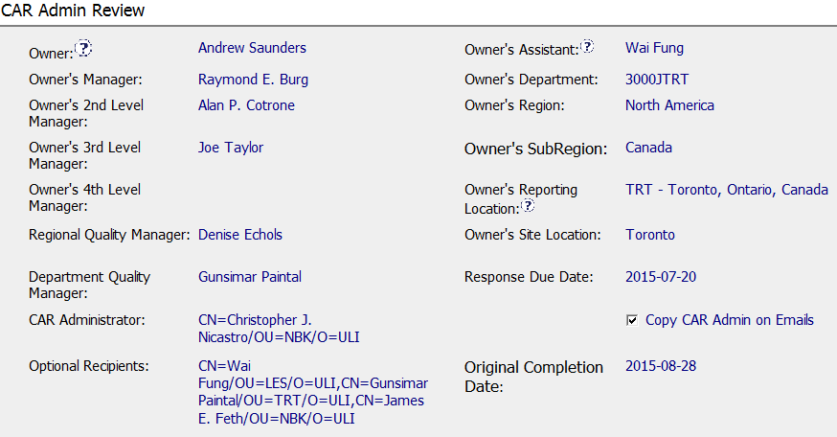
CAR 153914905 – Exemplary CAR (Finding)
Business Unit Presidents and other identified executives have been removed from the CAR escalation chain and replaced with Joe Taylor.
Correct NA CPO Optional Recipient added for Accreditor Finding CAR.

Slide 7

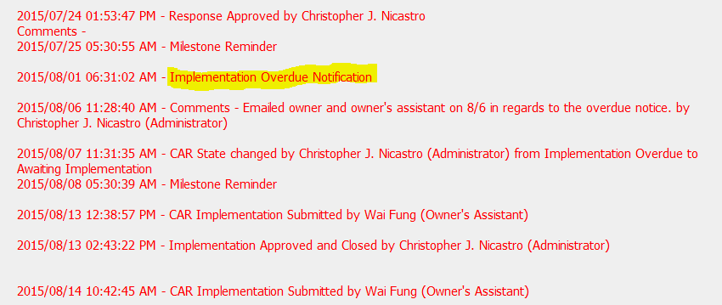
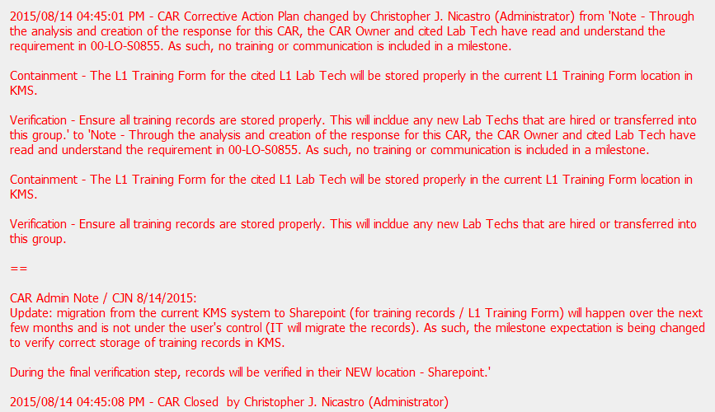
CAR 153914905 – Exemplary CAR (Finding)
Good support of the CAR Owner and collaboration w/Global Quality
Evidence of communication for overdue CAR
Note added before closing the CAR to explain the minor change in the CAP.

Slide 8
CAR 153914905 – CBS Check
CBS Requirements | Excellent | Moderate | Need Improve | N/A
INTEGRITY
(C) Extensions are within requirement (<30 days, 3 or less) | X
(T) Most appropriate ‘category’, ‘type’, ‘geography’ are selected | X
(P) Facilitates the handling of disputed CARs |  |  |  | X
(T) Acts on CARs within required timeframe | X
COMPETITIVENESS
(C) Analysis shows clear path to root cause and scope; stakeholders identified | X
(C) Root cause statement is succinct, reasonable, complete (Shows ‘N/A’ for observations) | X
(C) Corrective actions fix the objective evidence and other problems found; address entire root cause and scope. For observations, they do not go beyond fixing the objective evidence | X
(C) Milestones address containment & owner’s verification; completed per milestone expectations | X
(P) Verification per requirements | X
COLLABORATION
(L Referenced communications are attached as needed | X
(C L) Evidence of communication for overdue/escalated CARs and other pertinent concerns | X
(P) Trains other CAR Champions |  |  |  | X

